Slide 1
Nuclear Thermal Propulsion at The Ohio State University
Noah Gula (gula.8@osu.edu)
April 13, 2021

Slide 2
Presentation Overview
NTP at OSU
A brief history of nuclear thermal propulsion.
When did it all start?
Project Rover and NERVA
Cancelling NERVA
Isn’t NTP dead?
How exactly does NTP work?
What are the governing equations and principles?
How does it stack up against other forms of propulsion?
What are the challenges associated with NTP?
What are we doing at OSU to deal with them?

Slide 3
A Brief History of Nuclear Thermal Propulsion

Slide 4
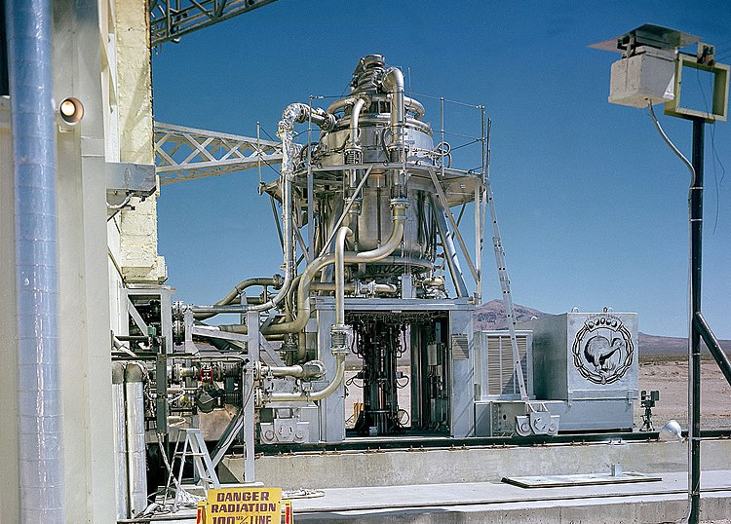
When did it all start?
NTP at OSU
Originally, NTP was first developed for aircraft by the US Army Air Forces in 1946.
The goal was to develop an aircraft which used nuclear thermal energy to heat air as it passed through the engines.
An aircraft carrying a nuclear reactor was flown 47 times, but the reactor never powered the aircraft.
The program was eventually cancelled in 1961 by JFK.
[1] Los Alamos National Laboratory, http://www.lanl.gov/newsroom/photo/history.php
Notes:
Pictured is a Kiwi Prime A nuclear reactor on the test stand at the Atomic Energy Commission’s Nevada Test Site.

Slide 5
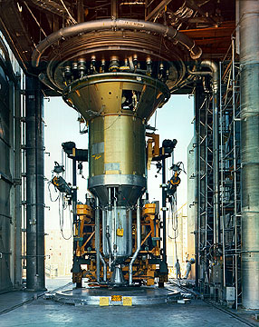
Project Rover and NERVA
NTP at OSU
Project Rover intended to build a nuclear-powered stage for an ICBM, started in 1955 by Los Alamos Scientific Laboratory.
When NASA was created in 1958, it partnered with the Atomic Energy Commission (now the Department of Energy) to manage the project.
The program produced three different types of reactors, all using Highly Enriched Uranium (HEU).
By 1957, a nuclear upper stage was no longer needed. But something else came up that increased interest in NTP...
Eventually, the project transformed into the Nuclear Engine for Rocket Vehicle Application (NERVA) in 1961.
In all, NERVA was tested six times between 1964-1969 before being cancelled.
[2] Department of Energy, https://web.archive.org/web/http://www.nv.doe.gov/library/photos/photodetails.aspx?ID=824
Notes:
Pictured is the NERVA XE in Engine Test Stand-1. The two technicians at the bottom right provide a sense of scale.
In 1957, the Soviet Union launched Sputnik-1, leading to the creation of NASA.

Slide 6
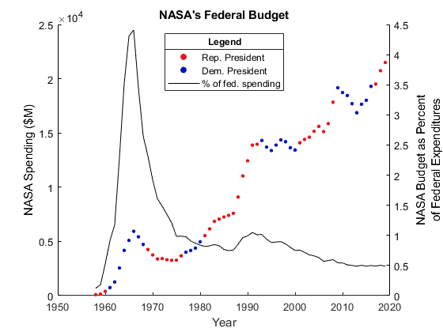
Cancelling NERVA
NTP at OSU
By 1970, a battle between Congress and Pres. Nixon emerged.
Nixon repeatedly tried to cancel NERVA, but Congress continued to (inadequately) fund the project through 1972.
Concerns by Congress and the public grew over the safety of NTP.
In early 1973, NASA announced the program was cancelled.
After 17 years, $8.81B was spent (in 2021 USD). Biden recently proposed a $24.7B budget for NASA in 2022.
Notes:
Chart shows the “crash program” of NASA during the Apollo era. Data from congressional appropriations bills, visualization my own.

Slide 7
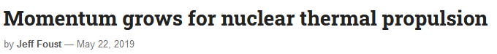
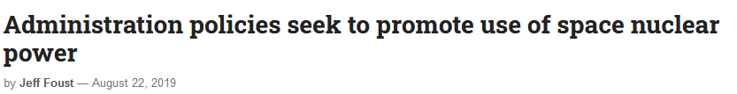
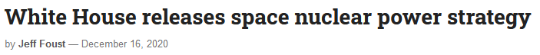
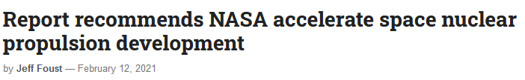
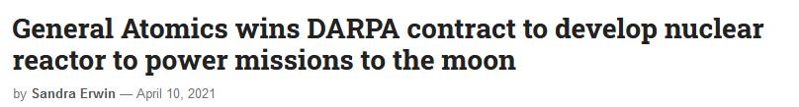
I thought NTP was “dead”?
NTP at OSU
https://spacenews.com/momentum-grows-for-nuclear-thermal-propulsion/
https://spacenews.com/administration-policies-seek-to-promote-use-of-space-nuclear-power/
https://spacenews.com/white-house-releases-space-nuclear-power-strategy/
https://spacenews.com/report-recommends-nasa-accelerate-space-nuclear-propulsion-development/
https://spacenews.com/general-atomics-wins-darpa-contract-to-design-nuclear-reactor-to-power-missions-to-the-moon/
Notes:
Just a handful of recent articles discussing the future of NTP.

Slide 8
How exactly does Nuclear Thermal Propulsion work?

Slide 9
NTP Operation
NTP at OSU
Hydrogen Tank
Turbine
Pump
~40%
Core
~60%
Nozzle

Slide 10
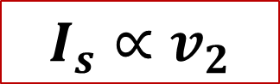
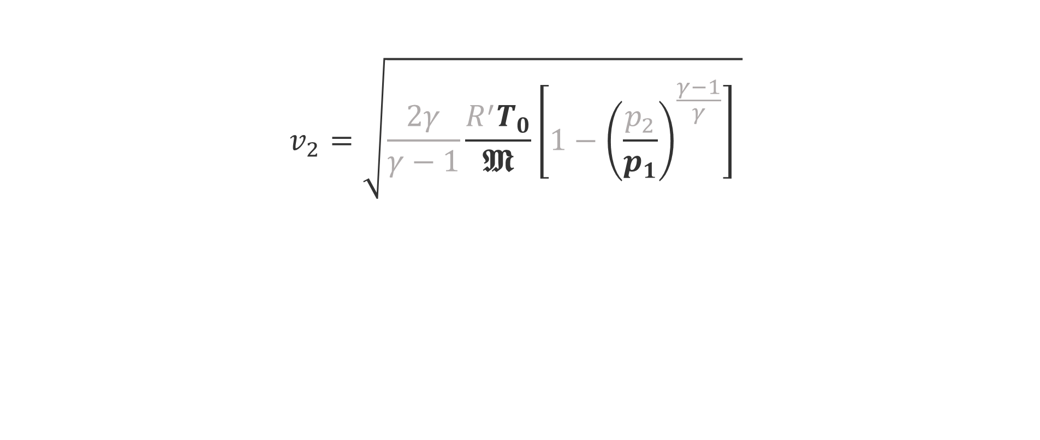
Fundamental Governing Equation
NTP at OSU
Chamber Temperature
(big is good)
$$v_{2}=\sqrt{\frac{2γ}{γ−1}\frac{R^{′}T_{0}}{𝕸}\left[1−{\left(\frac{p_{2}}{p_{1}}\right)}^{\frac{γ−1}{γ}}\right] }$$
H₂: 1 g/mol
CO₂: 44 g/mol
H₂O: 18 g/mol
Chamber Pressure
(big is good)
Propellant Molar Mass
(small is good)
$$I_{s}∝v_{2}$$
To increase performance, we need high temperature and high strength materials!

Slide 11
How does NTP compare to chemical?
NTP at OSU
NTP is comparable to other types of chemical propulsion (including solid and liquid).
It enjoys a much higher efficiency (specific impulse) while still achieving a similar thrust to weight ratio.
Best application is for in-space propulsion.
Thanks to its higher specific impulse, NTP is a viable candidate for human spaceflight missions to Mars.

Slide 12
NTP Operation
NTP at OSU
Hydrogen Tank
Turbine
Pump
~40%
Tie Tube
Core
~60%
Nozzle

Slide 13
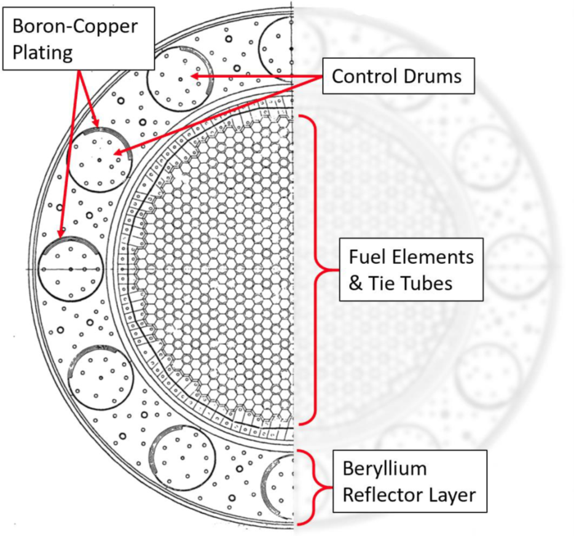
Cross-Section of the NERVA Core [4]
NTP at OSU

Slide 14
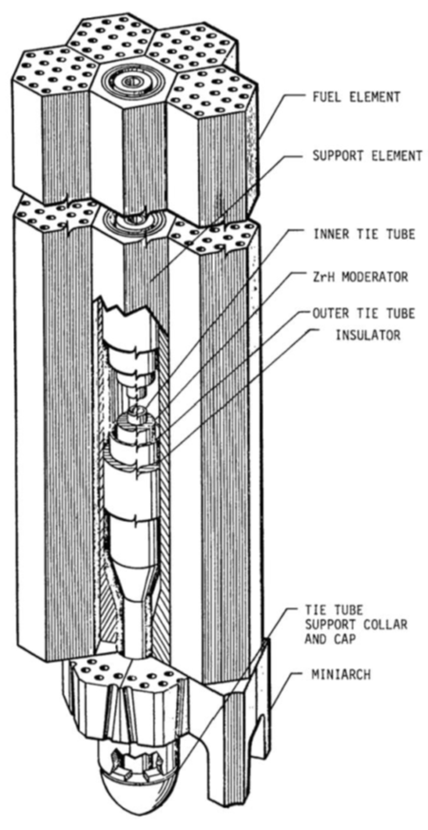
Tie Tube Detail
NTP at OSU
In the NERVA HEU reactor core, each tie tube is surrounded by six fuel elements.
It servers three purposes:
To provide structural integrity to the core
To increase the enthalpy of the hydrogen before it goes to the turbine, and
To provide some amount of neutronic moderation.
Hydrogen flows through the inner tie tube, turns around at the bottom, and flows back up through the outer tie tube.
[5]

Slide 15
How is NTP different than chemical?
NTP at OSU
In a chemical rocket engine, when you stop the flow of propellant, the combustion stops.
When the combustion stops, the generation of heat in the engine stops.
In NTP, a nuclear reactor continues to emit “decay heat” for a long time after it is “turned off.”
If this decay heat is not delt with, the engine will melt.

Slide 16
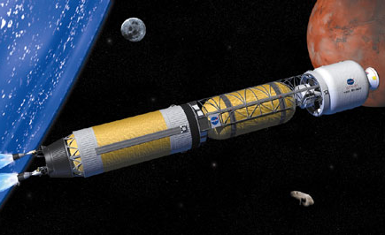
So how do you deal with the decay heat?
NTP at OSU
You must continue flowing hydrogen through the tie tubes in order to carry the decay heat away.
But it doesn’t all have to be wasted!
Instead of dumping overboard, make it a closed loop and use it to generate electricity (J. Clark, J. Plank)
It can still go through the nozzle and therefore contributes to thrust (D. Scott, J. Plank)
How do you know what amount of hydrogen is required to maintain the integrity of the engine? (J. Plank, N. Gula)
NASA. https://www.nasa.gov/centers/glenn/images/content/101877main_BNTR_concept_516x266.jpg

Slide 17
Use of real-time simulations [4]
NTP at OSU
To optimize the propellant flow rate, we want to find the minimum mass flow which maintains the moderator temperature below 800 K.
This is accomplished by using real-time simulations (in Ansys, Simulink, etc.).
The temperature of the core, hydrogen pressure, and current mass flow rate are supplied as boundary conditions, and the model tries to figure out what the minimum flow rate is required.

Slide 18
Use of real-time simulations [4]
NTP at OSU
To optimize the propellant flow rate, we want to find the minimum mass flow which maintains the moderator temperature below 800 K.
This is accomplished by using real-time simulations (in Ansys, Simulink, etc.).
The temperature of the core, hydrogen pressure, and current mass flow rate are supplied as boundary conditions, and the model tries to figure out what the minimum flow rate is required.

Slide 19
Use of real-time simulations [4]
NTP at OSU
Jack Plank performed computational simulations and found that up to forty percent of hydrogen could be saved in the cool-down phase (!!!)
But how do we know that the computational model behaved correctly? We need experimental results.

Slide 20
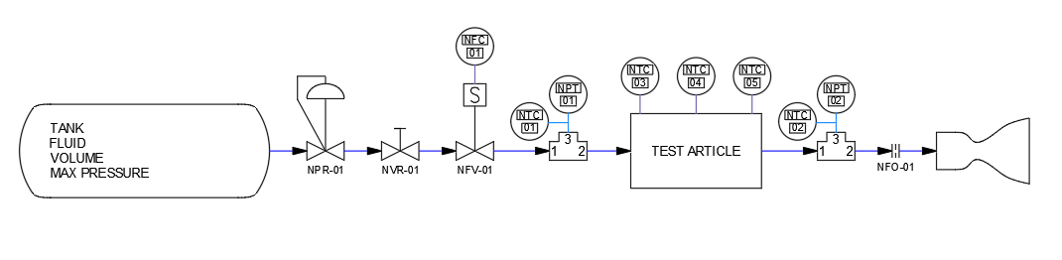
Test Stand P&ID
NTP at OSU
Upstream Flow Conditions (Pressure + Temperature)
Downstream Flow Conditions (Pressure + Temperature)
Nitrogen Supply Tank
Pressure Regulator
Test Article Thermocouples
Optional Exhaust Nozzle
Manual “Run” Valve
Tie Tube & Heat Sink
Optional Orifice
Mass Flow Controller

Slide 21
Test Article Design
NTP at OSU

Slide 22
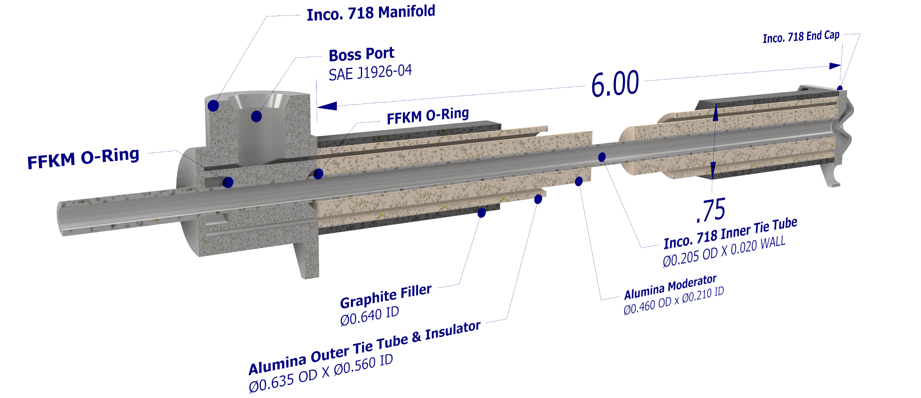
Test Article Design
NTP at OSU

Slide 23
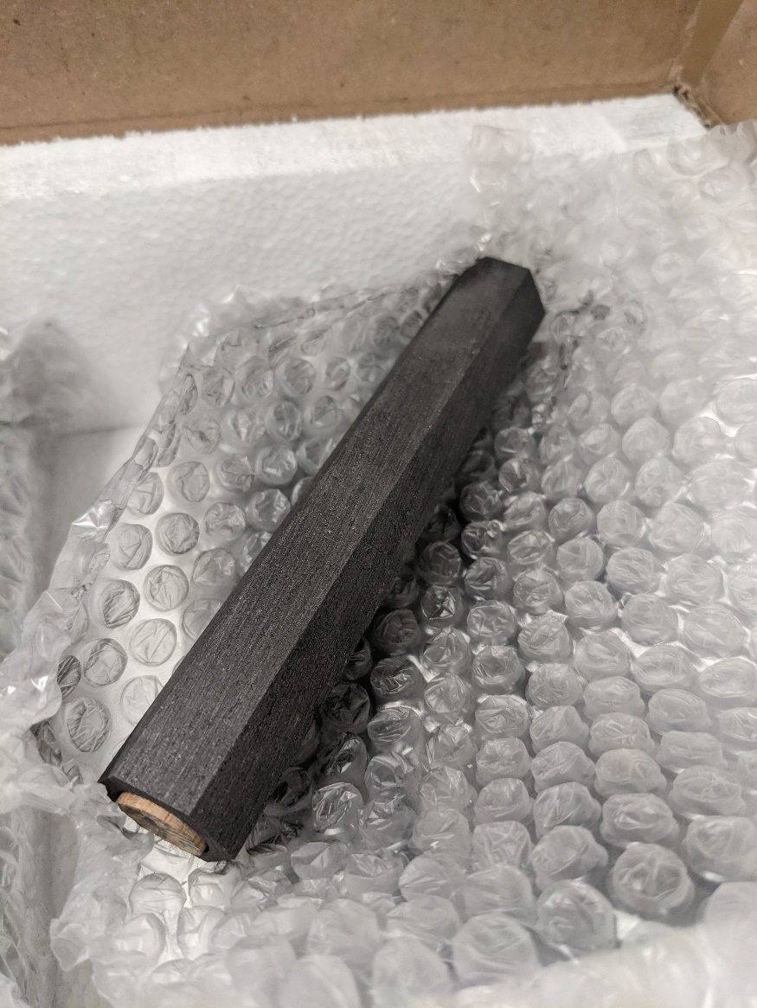
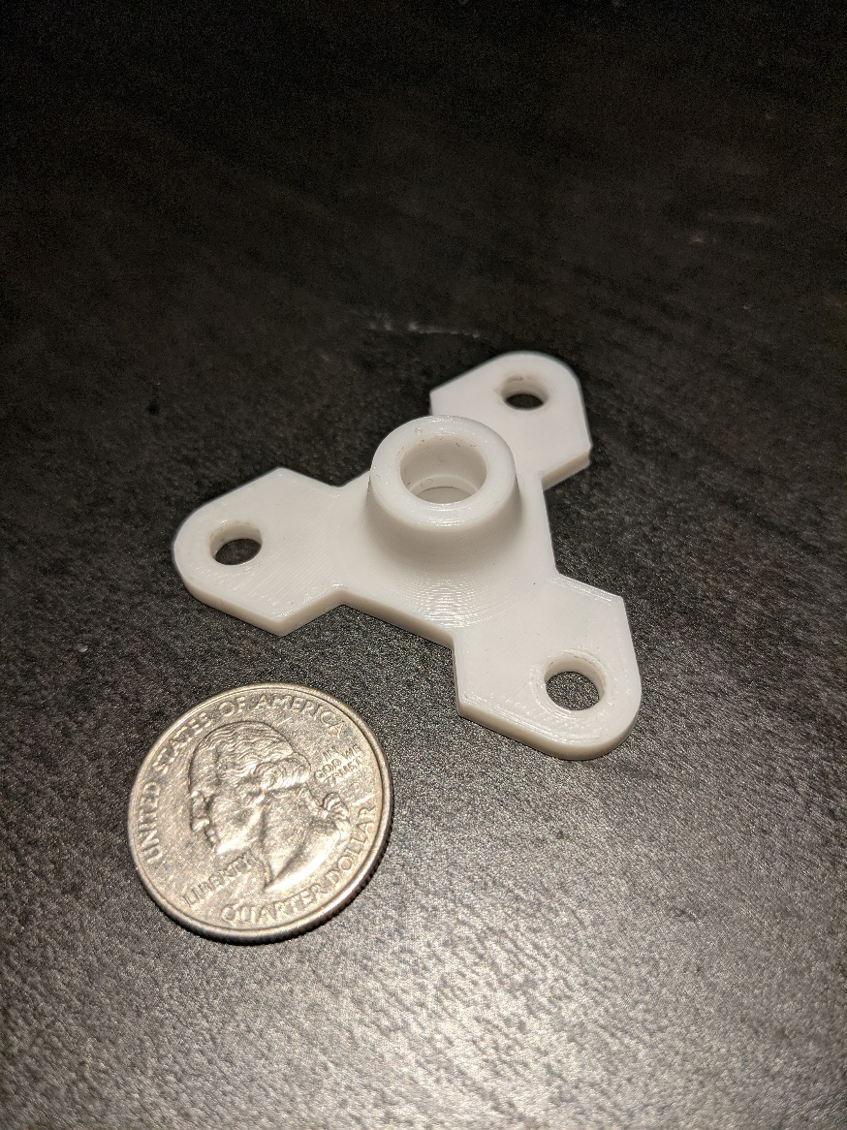
Cap and Graphite Filler Structure
NTP at OSU

Slide 24



Data Acquisition and Control System
NTP at OSU
Lab Computer with Python/MATLAB
Data/Command Processing
Arduino Mega (2560 R3)
Data Acquisition
Arduino Uno (R3)
Controller

Slide 25

Control System Cycle
NTP at OSU
Simscape/Ansys determines optimal mass flow rate
Serial port sends data
Serial port sends command
Arduino Mega collects test article data
Test article responds to new conditions
Arduino Uno sends mass flow command

Slide 26

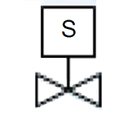
Control System Overview
NTP at OSU
Heater controller
Arduino Uno (R3)
Controller
Nitrogen tank
Test article
FT

Slide 27
Questions?

Slide 28
Extra Slides

Slide 29
Other OSU Efforts
NTP at OSU
Is there a better regen channel geometry which allows hotter chamber temperatures? (N. Salamon)
Can we realize this in an additively manufactured prototype? (K. Melendez et al.)
Is dead reckoning a viable navigational method for NTP burns (J. D. Kostik et al., A. Montanez et al.)

Slide 30
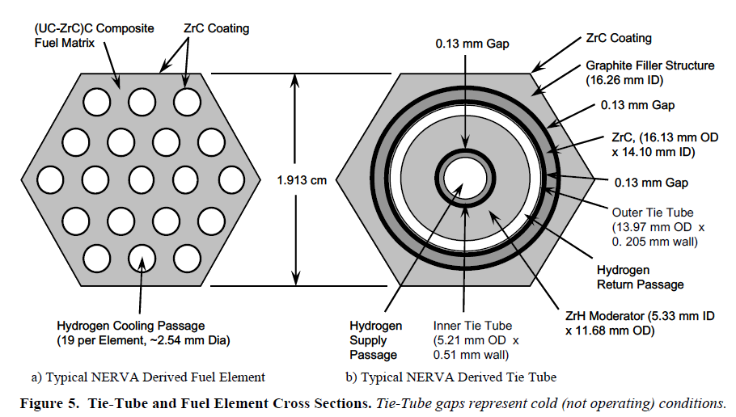
Tie Tube and Fuel Element Cross Section
NTP at OSU
[6]

Slide 31
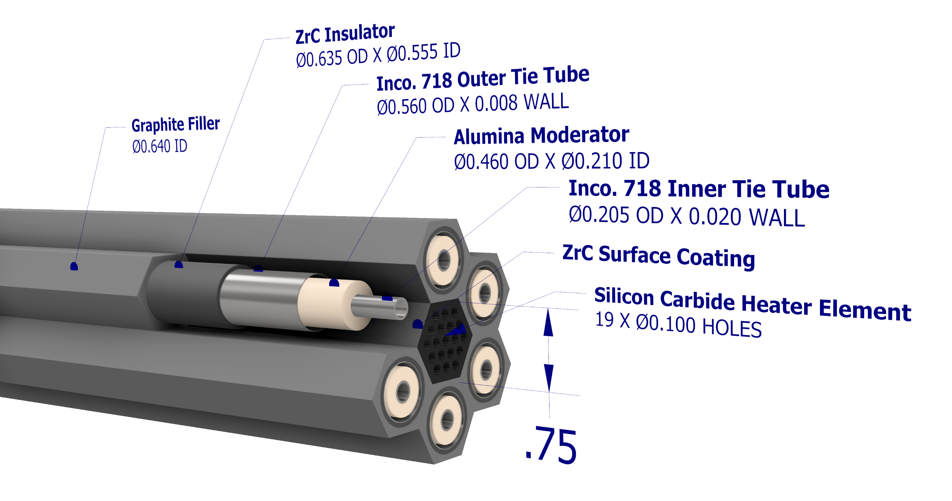
HALEU Inverted SNRE
NTP at OSU

Slide 32
Reference
NTP at OSU
[1] Unless otherwise indicated, this information has been authored by an employee or employees of the Los Alamos National Security, LLC (LANS), operator of the Los Alamos National Laboratory under Contract No. DE-AC52-06NA25396 with the U.S. Department of Energy. The U.S. Government has rights to use, reproduce, and distribute this information. The public may copy and use this information without charge, provided that this Notice and any statement of authorship are reproduced on all copies. Neither the Government nor LANS makes any warranty, express or implied, or assumes any liability or responsibility for the use of this information.
[2] Photo courtesy of National Nuclear Security Administration / Nevada Field Office
[3] G. P. Sutton, O. Biblarz (2017) Rocket Propulsion Elements, 9th Ed. Wiley
[4] J. Plank (2021) Nuclear Thermal Propulsion Cool-Down Phase Optimization Through Quasi-Steady Computational Analysis, and the Effect of Auxiliary Heat Removal Systems. Ohio State University
[5] F. P. Durham (1979) Nuclear Engine Definition Study Preliminary Report Volume I – Engine Description. Los Alamos Scientific Laboratory
[6] Fittje, J. E., Borowski, & S. K., Schnitzler, B. (2015) Revised Point of Departure Design Options for Nuclear Thermal Propulsion. AIAA.

